Slide 1
Press Freedom and Stability
By Sam Freed

Slide 2
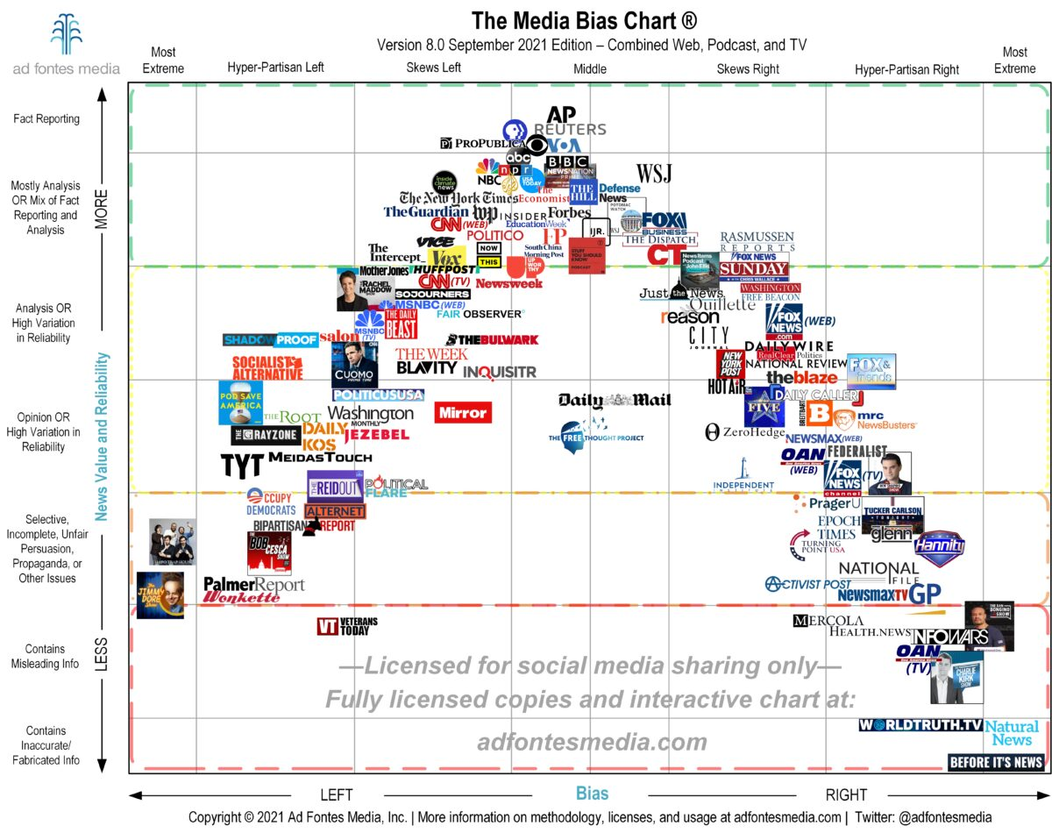
Does this look familiar?

Slide 3
Objectives and Methods
Is there a correlation between press freedom and perceived fragility?
How free is the US press? How has this changed recently?
How stable is the US compared to other countries?
Collect data from trusted sources and compare at surface level
Provide statistics about incidents and attacks against journalists
Chart data from other Anglosphere countries and check for trends

Slide 4
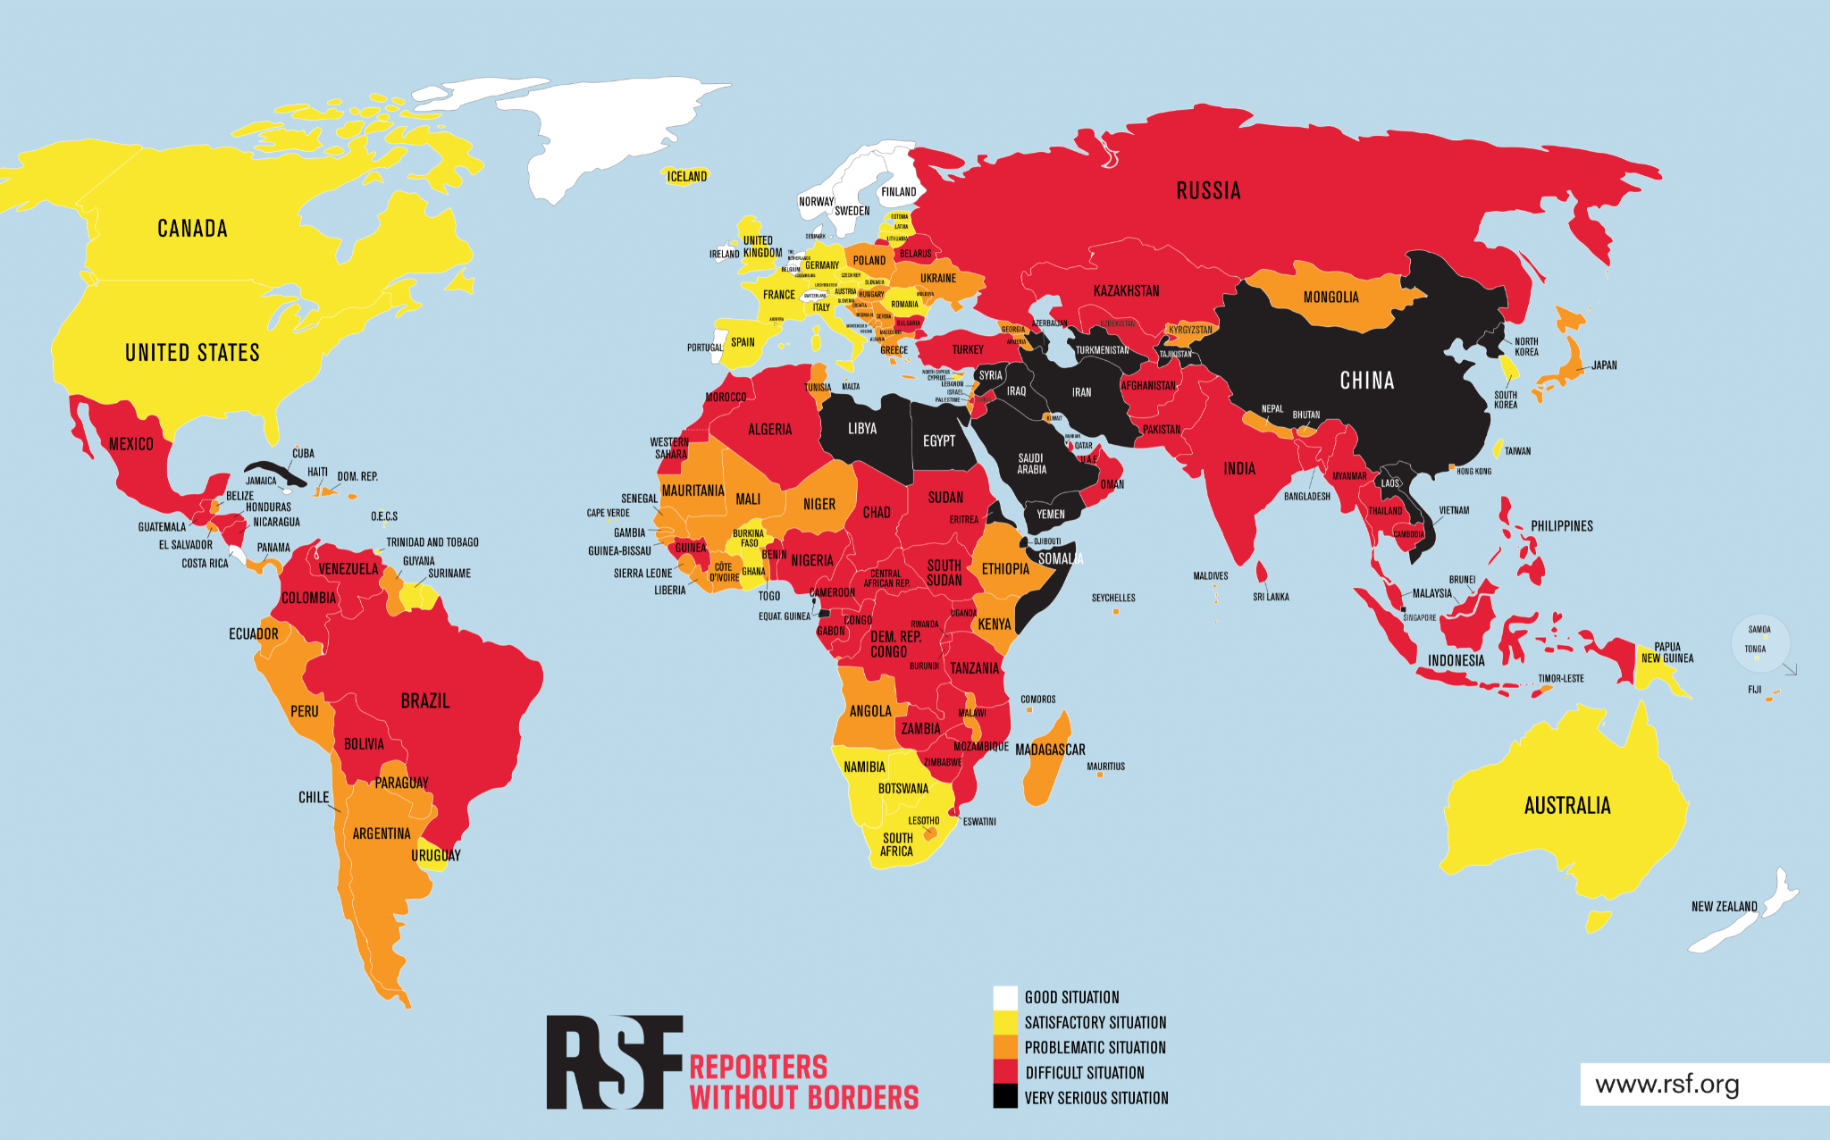
Press Freedom -
Reporters without Borders
(Reporters sans frontières)
Based on an “abuse score” and an “underlying situation score”
Questionnaire translated into 20 languages for 180 different countries
Tracked since 2002
US: 23.93 (44th/179)

Slide 5
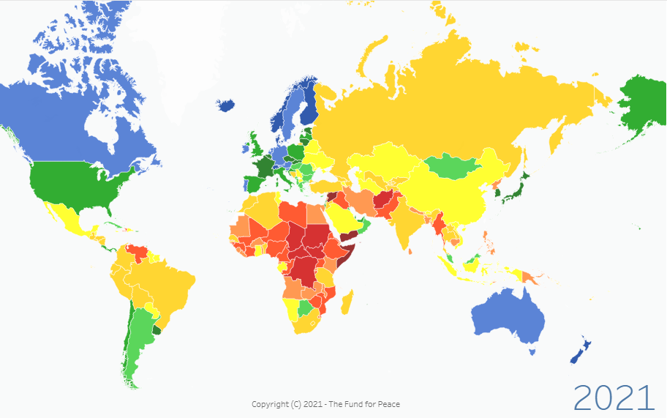
National Stability -
Fragile States Index
(The Fund for Peace)
Four groups of indicators:
Cohesion
Economics
Political
Social
Lower ranking is worse
US: 44.6 (143rd/179)

Slide 6
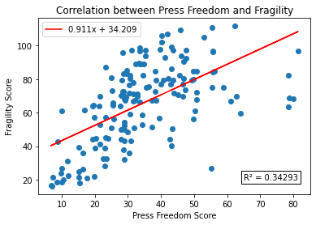
Is there a correlation?

Slide 7
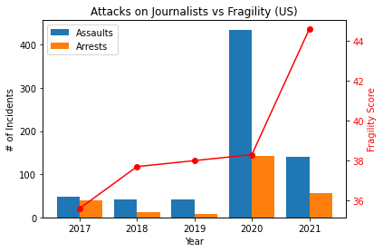
Case Study: The US
Data provided by the US Press Freedom Tracker
10x increase in 2020 due to presence during social movements and shift in public opinion
Clear that there is at least correlation post-2020

Slide 8
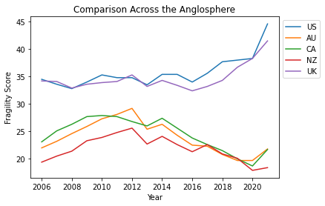
Comparison with Anglosphere
Anglosphere is defined as the US, Australia, Canada, New Zealand, and the United Kingdom
US and UK both facing significant political debates and uncertainty (political distancing, rise in nationalism)

Slide 9
Conclusions
Correlation? With such a low R² score, it is hard to say that there is much of a correlation, contrary to my initial belief.
What about the US press? Last year is (hopefully) an anomaly, with our press overall being free and safe.
How do we match up? In comparison to other culturally similar countries, we end up on the higher end of the scale.

Slide 10
Sources
2021 World Press Freedom Index. Reporters Without Borders. (2021). Retrieved December 2, 2021, from https://rsf.org/en/ranking_table.
Country Dashboard. Fragile States Index. (2021). Retrieved December 2, 2021, from https://fragilestatesindex.org/country-data/.
Global Data. Fragile States Index. (2021). Retrieved December 2, 2021, from https://fragilestatesindex.org/global-data/.
U.S. Press Freedom Tracker. (2021, November 24). Retrieved December 2, 2021, from https://pressfreedomtracker.us/.

